Slide 1

Airline Fare Prediction Presentation
13 Slides

Slide 2
Business: Airline Industry Domestic Travel within India It is in airlines’ best interest to make sure people can afford to fly with them, so they want to offer good prices. But they also need to find the right balance between (a) making sure they fill up a flight and (b) earning enough money to justify all the costs that go into operating the journey. For this reason, ticket prices will drop and rise very regularly, depending on many different factors that are specific to that particular flight. Those things can include: Of course, this depends on a ton of different and ever-changing factors, like how well that particular flight or route is selling.
Problem statement
Flight ticket prices can be something hard to guess, today we might see a price, check out the price of the same flight tomorrow, it will be a different story. We might have often heard travellers saying that flight ticket prices are so unpredictable. Here you will be provided with prices of flight tickets for various airlines between the months of March and June of 2019 and between various cities
Project Proposal:
Using Predictive analytics to build a model to forecast and to understand the reasons of airfare fluctuation throughout the given period for domestic flights & domestic travel within India.

Slide 3
ABOUT DATASET:
We have given a dataset of flight ticket prices which is of shape (10683, 11). In this problem we have to predict the price of a flight ticket.
IMPORTING DATASET:
Given file is in the form of an excel file so we have to use pandas read_excel to load the data. After loading it is important to check the complete information of data as it can indicate much of the hidden information such as null values in a column or a row. There is one NA value which we drop it. Describe data which can give statistical analysis of it.
EXPLORATORY DATA ANALYSIS:
From description we can see that Date_of_Journey is a object data type, Therefore, we have to convert this datatype into timestamp so as to use this column properly for prediction. For this we require pandas to_datetime to convert object data type to datetime dtype. .dt.day method will extract only day of that date**\ **.dt.month method will extract only month of that date Extracting Day AND Extracting month from the column Date_of_Journey
Since we have converted Date_of_Journey column into integers, Now we can drop as it is of no use. 2. Departure time is when a plane leaves the gate. Similar to Date_of_Journey we can extract values from Dep_Time. Extracting hour AND Extracting minutes from the column Dep_Time Now we can drop Dep_Time as it is of no use 3. Duration is the difference of dep time and arrival time. Extract minutes and hours from the durations. Then add new two columns duration_hours and duration_mins list to dataframe.

Slide 4
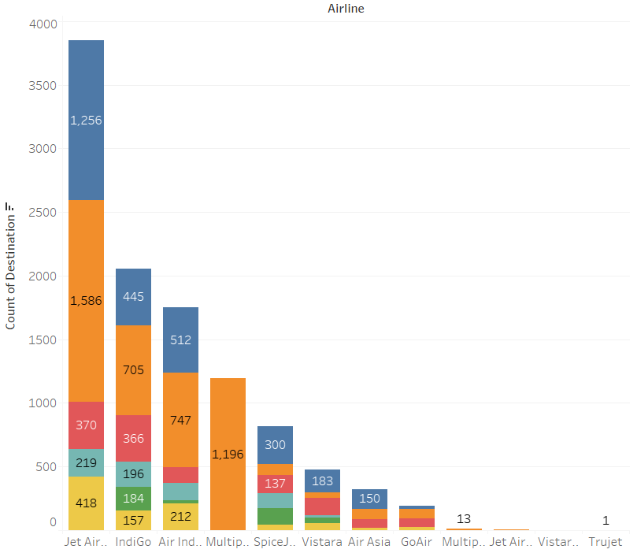
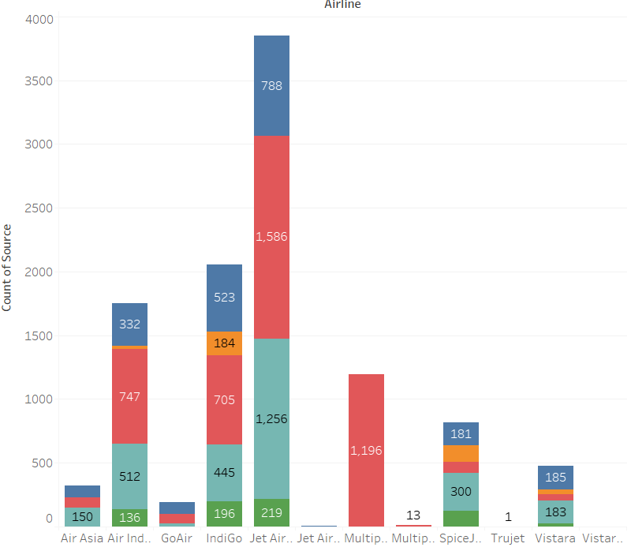
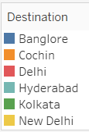
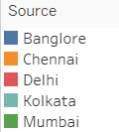
COUNT OF ARRIVING CITY W.R.T TO FLIGHTS
COUNT OF SOURCE CITY W.R.T TO FLIGHTS

Slide 5
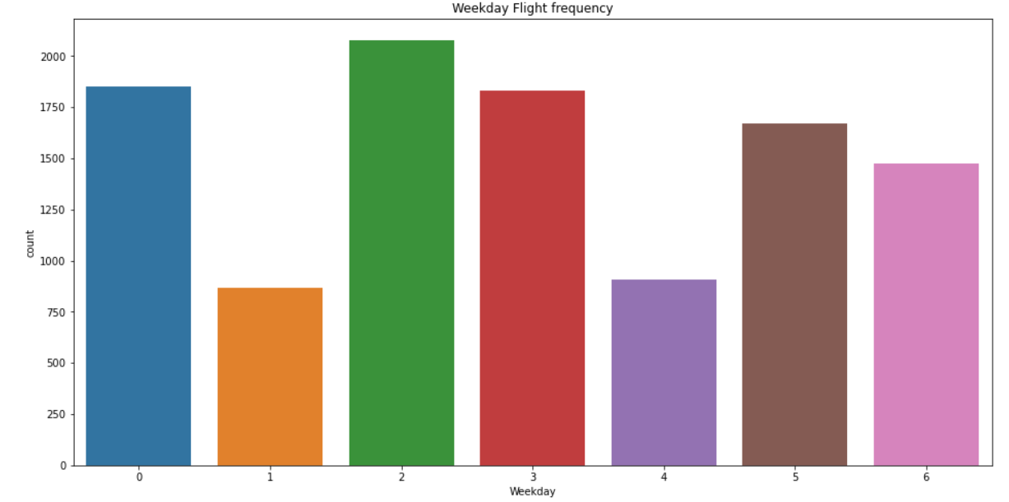
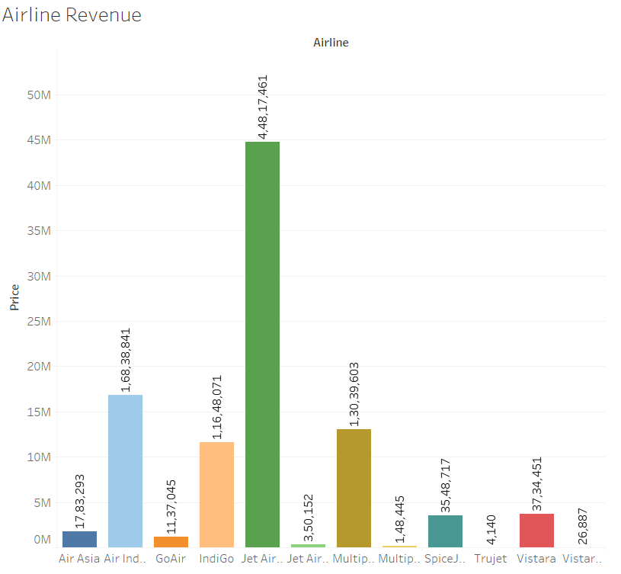
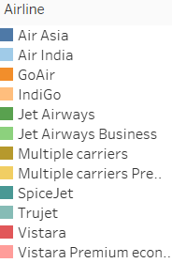
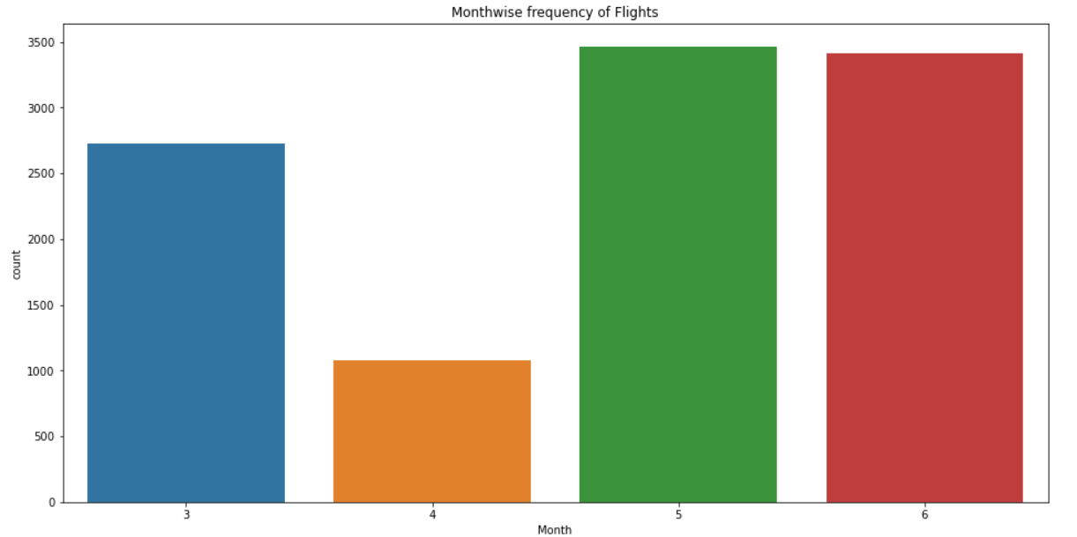

Slide 6
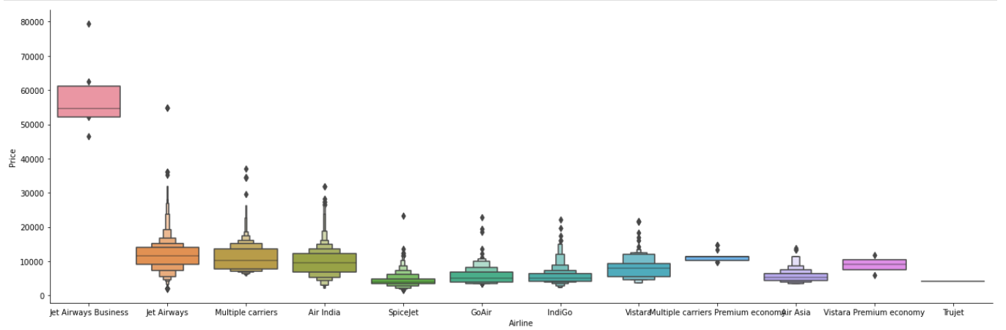
HANDLING CATEGORICAL DATA:
NOMINAL DATA:
Nominal data is data that can be labeled or classified into mutually exclusive categories within a variable. These categories cannot be ordered in a meaningful way. For handle such data we used OneHotEncoder. In this dataset Nominal data are:
Airline
Source
Destinations
Additional_Info

Slide 7
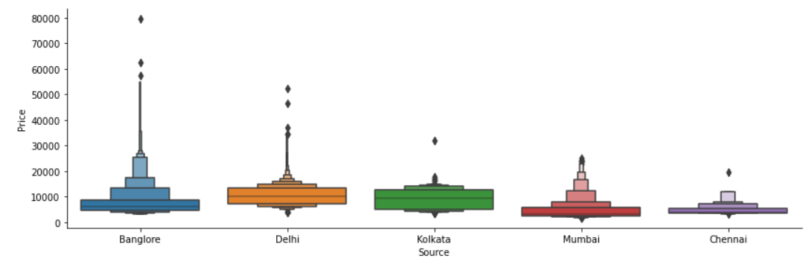
ORDINAL DATA:
In statistics, ordinal data are the type of data in which the values follow a natural order. One of the most notable features of ordinal data is that the differences between the data values cannot be determined or are meaningless. For handle such data we used LabelEncoder. In this dataset Ordinal data is:
Total_stops
OneHotEncoding:
Performing OneHotEncoding on these above Nominal Data. In this graph we can clearly see that Jet Airways Business has the highest Price. Apart from the first Airline almost all are having similar median
Almost similar median. ● Route and Total_Stops are related to each other.Therefore drop the Route.
From Additional_Info extract the ‘No check-in baggage included’ and ‘In-flight meal not included’. Then drop the Additional_Info column and add two new columns ‘No check-in baggage included’ and ‘In-flight meal not included’.
LabelEncoding:
As this is case of Ordinal Categorical type we perform LabelEncoder. Perform LabelEncoding on the Total_stops "non-stop": 0, "1 stop": 1, "2 stops": 2, "3 stops": 3, "4 stops": 4 .
FEATURES SELECTION:
Finding out the best feature which will contribute and have good relation with target variable. Following are some of the feature selection methods, heatmap feature_importance_ SelectKBest

Slide 8
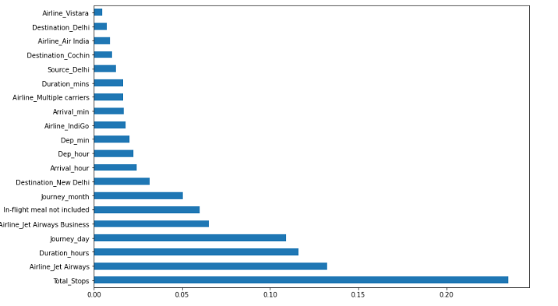
ExtraTreeRegressor:
To perform feature selection using ExtraTreeRegressor, during the construction of the forest, for each feature, the normalized total reduction in the mathematical criteria used in the decision of feature split (Gini Index if the Gini Index is used in the construction of the forest) is computed. This value is called the Gini Importance of the feature. To perform feature selection, each feature is ordered in descending order according to the Gini Importance of each feature and the user selects the top k features according to his/her choice. For this dataset Important feature Graph:
Here, we can see that Total_stops is one of the important feature which affect prices highly as we also see it in the heat map.

Slide 9
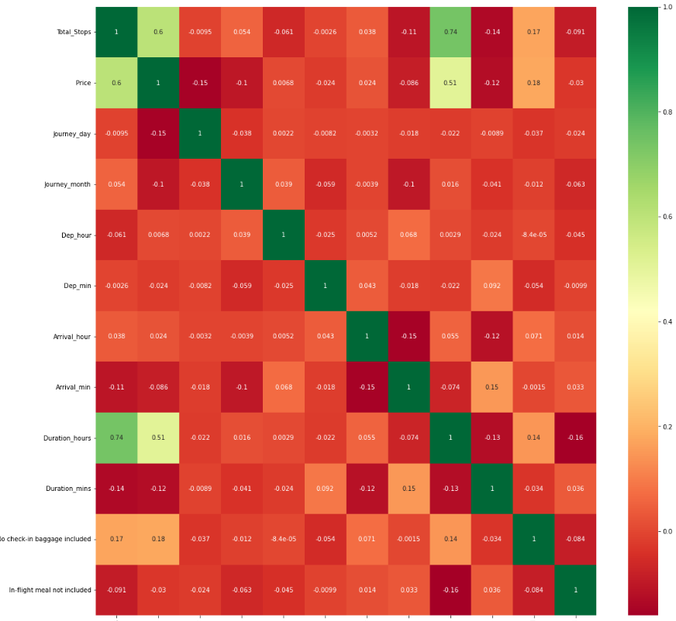
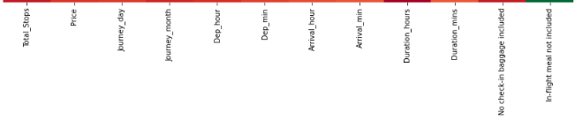
CORRELATION MATRIX:
Statisticians and data analysts measure correlation of two numerical variables to find an insight about their relationships. On a dataset with many attributes, the set of correlation values between pairs of its attributes form a matrix which is called a correlation matrix. Finds correlation between Independent and dependent attributes. Here, we can see that the variables depend on each other. Total stops have a highly positive correlation with prices. By observing this we can select the features which are highly correlated.

Slide 10
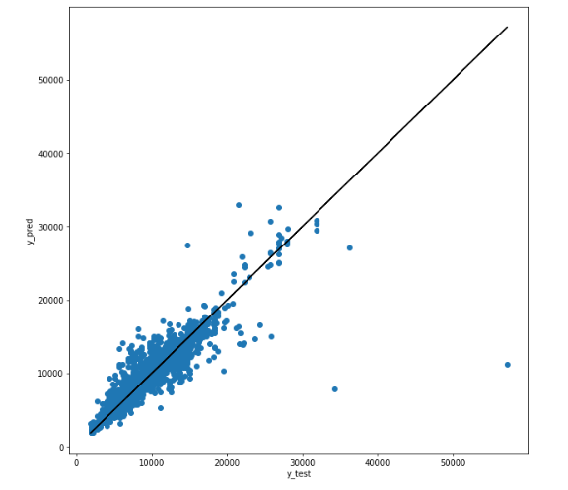
FITTING MODELS :
Model Fitting : RandomForestRegressor
This is the regression problem so I applied regression models in this dataset.
RandomForestRegressor: Using RandomForestRegressor using sklearn library.
● R^2 score on train dataset: 0.9770633013293992
● R^2 score on test dataset: 0.8620968227604909
● MAE: 804.3463478047694
● MSE: 2813352.593918533
● RMSE: 1677.3051582578923
Visualize the y_test and y_pred graph.

Slide 11
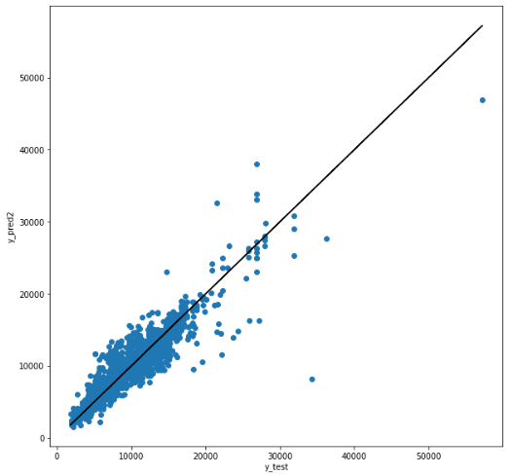
XgBoost: Using XgBoost using sklearn library.
● R^2 score on train dataset:0.963060144809135
● R^2 score on test dataset:0.8936472104393411
● MAE: 866.5499163218482
● MSE: 2169695.4513331465
● RMSE: 1472.988612085357
Visualize the y_test and y_pred graph.

Slide 12
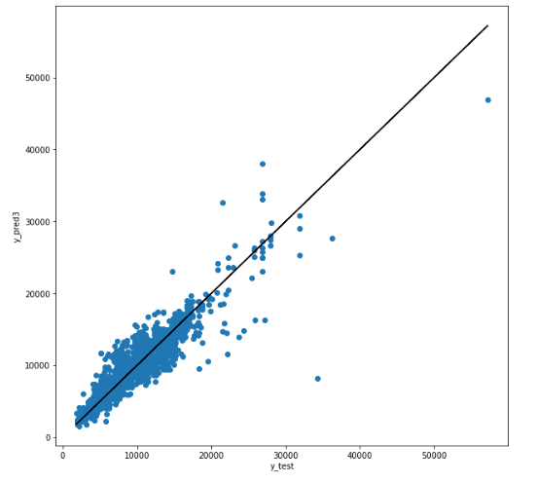
LightGBM Regressor: Using LightGBM using sklearn library.
● R^2 score on train dataset:0.8992678740590899
● R^2 score on test dataset: 0.8641622806709836
● MAE: 866.5499163218482
● MSE: 2169695.4513331465
● RMSE: 1472.988612085357
Visualize the y_test and y_pred graph.

Slide 13
Project analysis slide 5
Project Analysis

Slide 14
Thank You

